Slide 1
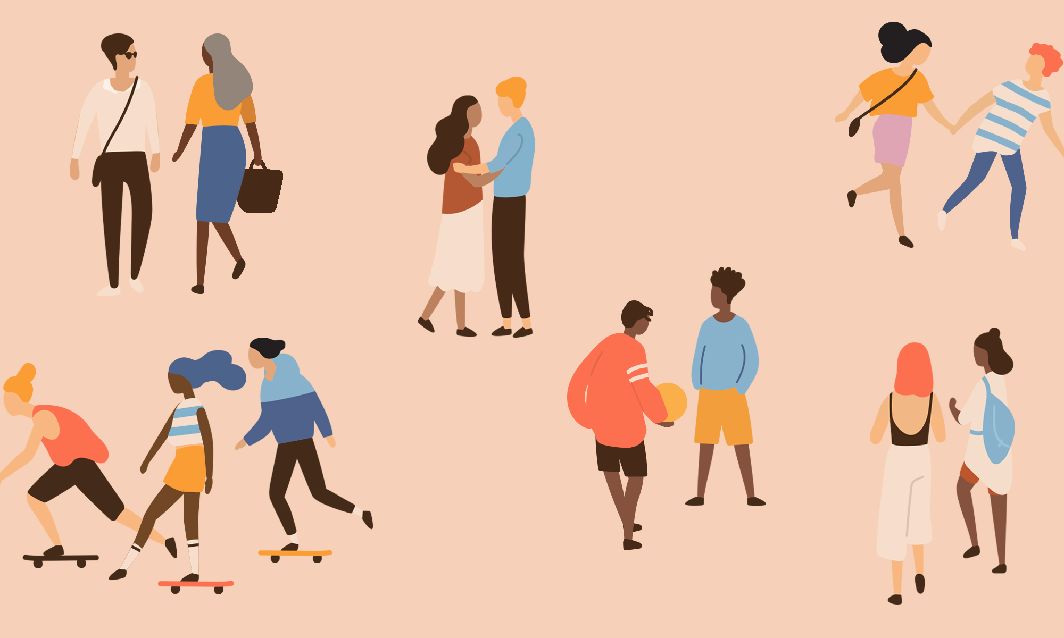
Relationships
Year 10 Health 2024
Lesson 2

Slide 2

Todays Focus:
Identify healthy and unhealthy relationship behaviours from a list of scenarios.
Define each aspect of the Love, Sex and Relationships Ethical Framework.
Evaluate different relationship scenarios to identify what is healthy, unhealthy, or needs improvement.
Define and give examples of rights and responsibilities in relationships.

Slide 3

Activity 1: Healthy or Unhealthy behaviours?
Each student will receive a card with a relationship scenario on it.
You have one minute to place it the section you feel it best fits.
Healthy
Unsure
Unhealthy
You will now have 3 minutes to look at the ‘Healthy’ and ‘Unhealthy’ piles and move any of them to the ‘Unsure’ pile if you think it doesn’t belong.
Leave the ‘unsure’ pile as it is.
Only move from healthy/unhealthy into the unsure pile.
Notes:
Optional hook activity.
Resources – relationship cards pack.
There are two sets of cards
set 1 = romantic relationships
set 2 = any kind of relationship.
Either set can be used – can be reused later if wanted.
Place the 3 headings on the board or on the floor: healthy, unhealthy, unsure.
Complete the activity as outlined in the slide.
Conclude with discussion below:
Discussion:
Firstly, discuss what is in the ‘unsure’ pile first as clearly students are unsure if those behaviours are healthy or not. Pull out a few and unpack which pile they should/could go to and why.
Secondly, discuss the unhealthy pile and pull out any talking points that you wish to emphasise. Can talk about consent here.
Thirdly, finish with discussions about what is in the healthy pile.
Conclude with the following statement – “I believe you are all entitled to having relationships that have these healthy behaviours and qualities, and have the capacity to work towards such behaviours”
Alternative: Continuum
Each student gets a card and together, the class places themselves in order of healthy characteristics to unhealthy characteristics, creating a continuum.
Ask each student to read out their paper and allow opportunities for discussion, the ability to move or ask questions about behaviours.

Slide 4
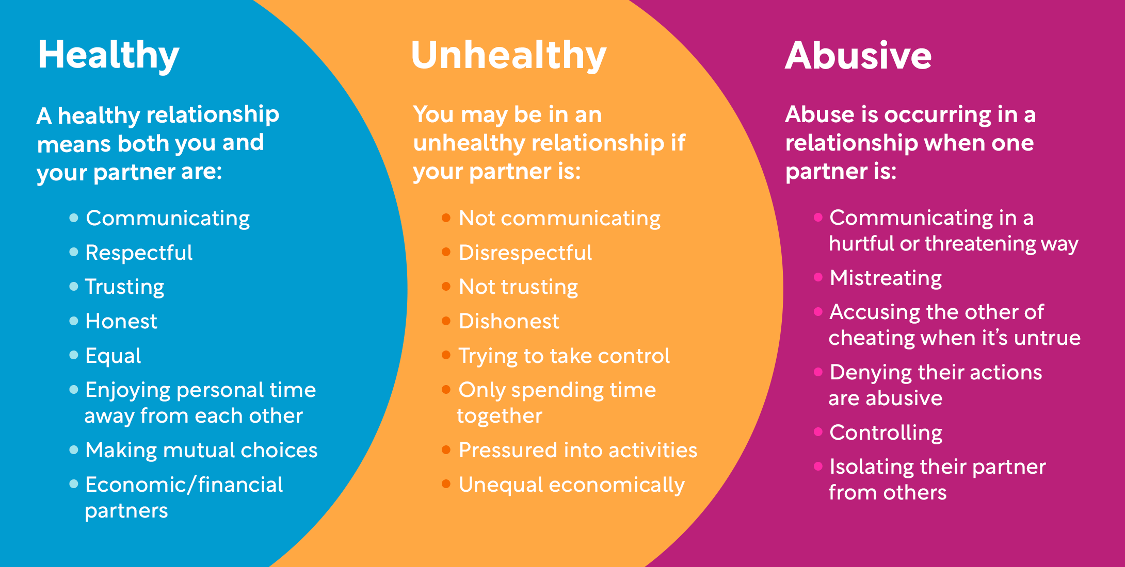
Healthy and Unhealthy Relationships
Notes:
Discuss the characteristics shown above.
This image can be found in their books.

Slide 5
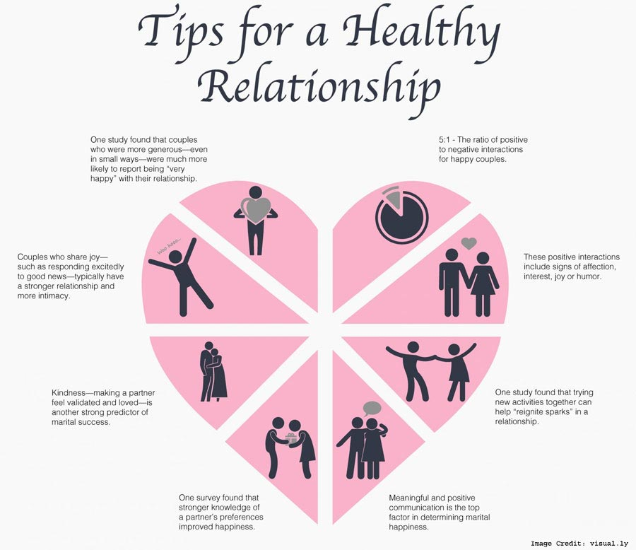
Notes:
Optional Discussion:
Discuss the characteristics shown above.
This image can be found in their books.

Slide 6
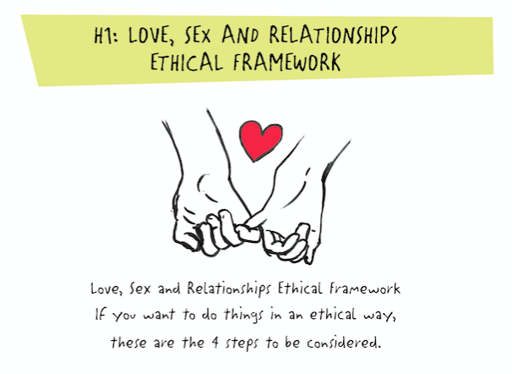
Activity 2: (pg.14) Love, Sex and Relationships Ethical Framework
There are several elements that must be in place for any relationship decision to be ethical, fair, safe and compassionate for all parties involved.
Use the information on the following slides to complete the Framework diagram in your books.
Notes:
Relevant to test

Slide 7
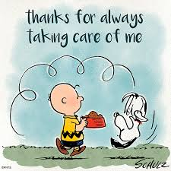
1. Taking Care of Me
This means asking:
Is this what I really want to do?
Am I safe emotionally and physically?
Is the other person treating me with respect and concern?
Notes:
Relevant to test

Slide 8
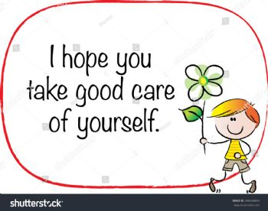
2. Taking Care of You
This means asking:
How does what I want effect the other person?
How do I know?
I’ve got to check if they are OK with the decision.
Notes:
Relevant to test

Slide 9
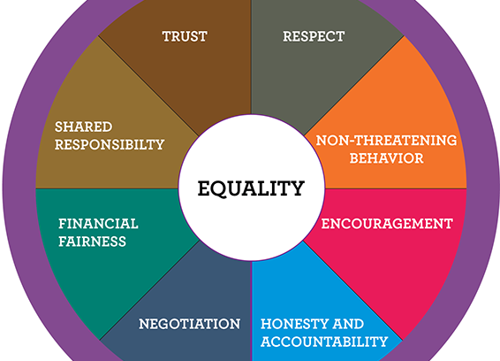
3. Having an Equal Say
This means asking:
Do we have equal power, or is one person getting their way most of the time?
When it comes to sex, a person owns their body and has the right to control who has pleasure from it.
Notes:
Relevant to test

Slide 10
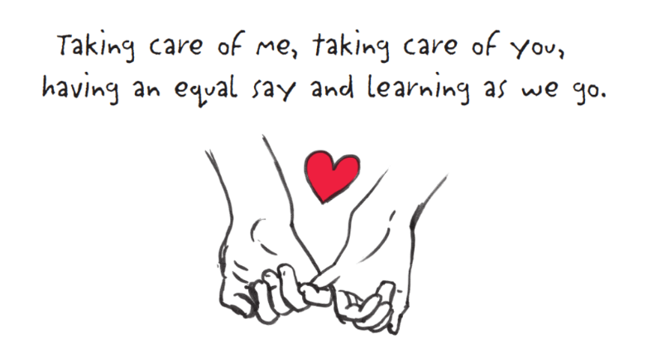
4. Learning as We Go
Few of us are born knowing how to ‘do’ relationships. We can learn and learn from our mistakes.
What would have made the situation better?
What am I doing?
What am I not doing?
What can I learn from this?
Notes:
Relevant to test

Slide 11
Activity 3: Relationship Scenarios (pg.15-16)
It is now time for you to evaluate different scenarios and consider if the Love, Sex, and Relationships Framework is being met.
Read each of the scenarios in your books and answer the following questions:
What healthy relationship qualities are evident? (If any)
What unhealthy relationship qualities are evident? (If any)
What aspects of the framework are being met?
You have 10 minutes.
Notes:
Relevant to test
Anything unfinished can be homework

Slide 12

GLOSSARY: (Pg. 7)
At the front of your books is your glossary. Turn to your glossary and add the following words and their definitions:
Rights:
Something you are entitled to, what everyone deserves.
Responsibilities:
Something that you are obliged to do or are accountable for.
Notes:
Relevant to test

Slide 13
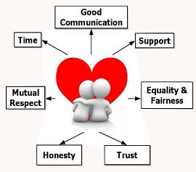
Rights and Responsibilities in Relationships: (pg.17)
Rights – something you are entitled to, what everyone deserves.
Responsibilities – something that you are obliged to do or are accountable for.
Just like human rights, there are basic rights and responsibilities we are entitled to within our relationships.
When establishing new relationships, it is important to have a clear idea of your own and the other person’s expectations.
Notes:
Relevant to test

Slide 14
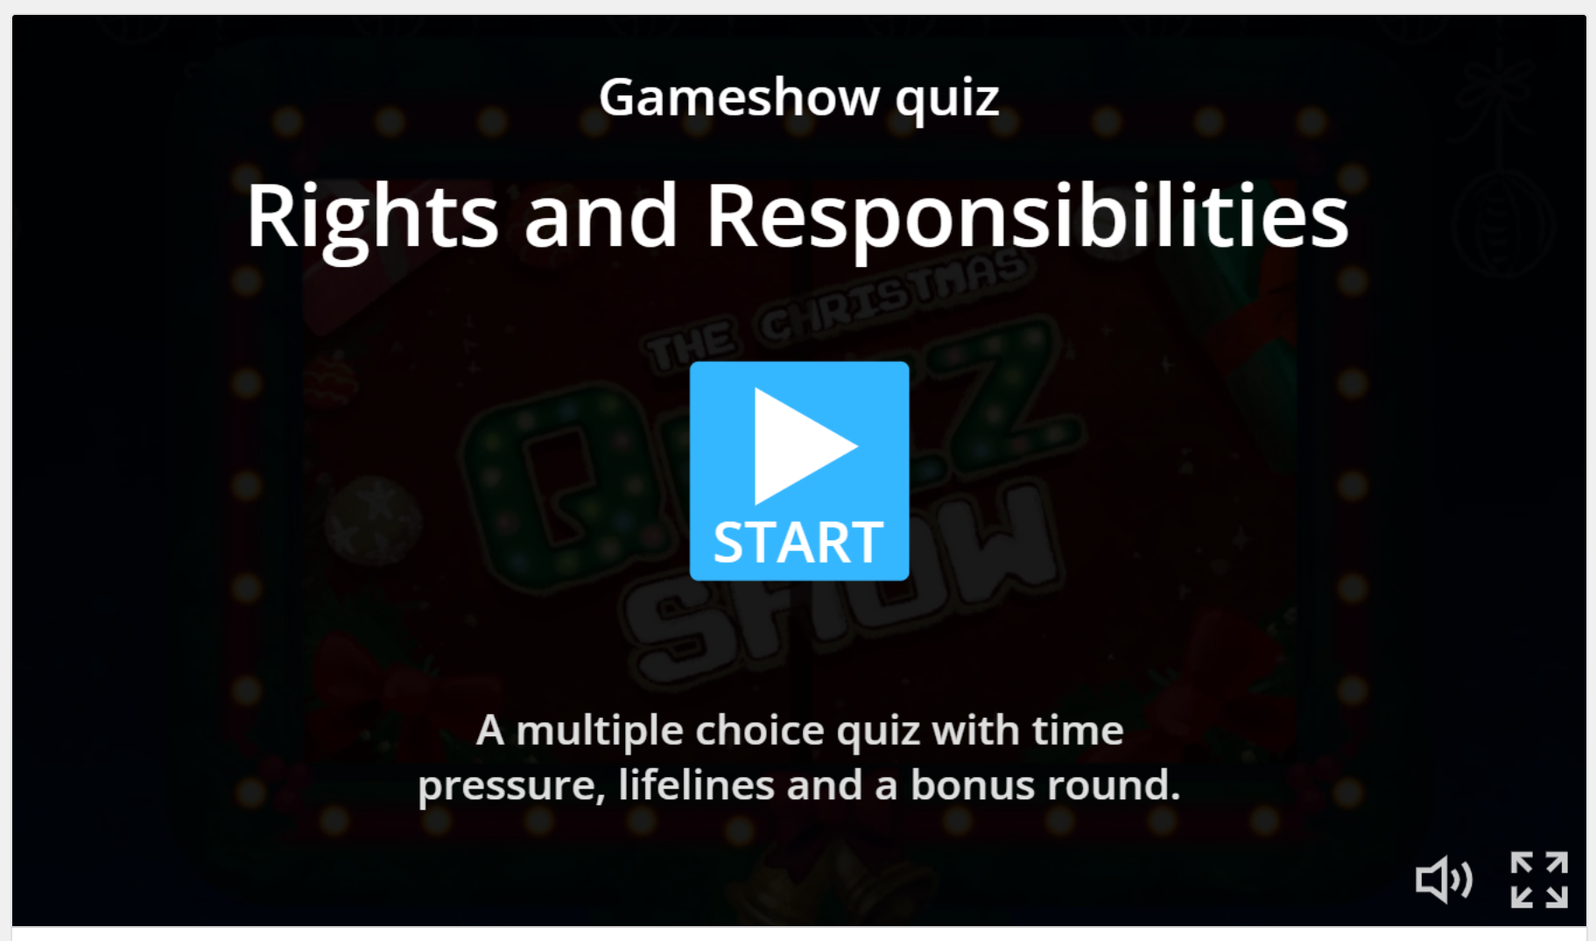
Optional Activity 4: Rights and Responsibilities
Go to the following link and complete the word wall activity.
https://wordwall.net/resource/52336873/rights-and-responsibilities
Notes:
https://wordwall.net/resource/52336873/rights-and-responsibilities
Optional activity – a good way to show examples of rights and responsibilities

Slide 15
Personal Reflection: (pg.17-18) Rights and responsibilities – do they change?
Consider the rights and responsibilities for the different relationships in your life.
For each relationship, write a list of rights and responsibilities that YOU have:
Parent/Child relationship
Teacher/Student relationship
Best Friend relationship
Sibling relationship
Romantic/Intimate relationship
Evaluate which rights and responsibilities were most common.
You have 10 minutes.
Notes:
Alternative – homework activity.
Relevant to test

